Slide 1

College DAtabase
ARİF TUNÇER 2110206029 AHMET KALE 2010206032 AHMET SEZER 2110206036
%30 2.Öğretim Group Number:4

Slide 2
SCENARIO
Karabük University uses a comprehensive database system to manage its academic operations. This system meticulously records and tracks information related to students, academicians, departments, courses, and exams within the university. Students are a fundamental part of the university, and each student is registered with unique details such as student ID, name, program name, and student type. Students are categorized as undergraduate, graduate, and Ph.D. students. Undergraduate students have information on their "degree," graduate students have "thesis topic," and Ph.D. students have "research area." Students enroll in specific courses (Enrollment), and these courses are evaluated through exams (Exams) held on designated dates. Each course is offered under a specific department and has details such as course code, course name, and the ID of the academician teaching the course. Courses are taught by academicians, who are registered in the system with an academician ID and name. Academicians also work within departments and each department is managed by a department head. Department heads are identified with a department ID and an academician ID in the system. Departments are crucial organizational units within the university, each with a unique name and code. Each department is led by a head and staffed with academicians who offer various courses to students. Students register for courses, attend them, and participate in exams for these courses, thereby actively engaging in the university's educational process. Academicians, in addition to teaching courses, also play roles in the administrative operations of their respective departments, ensuring the academic and administrative structure of the university functions cohesively. This database system enables the university to manage all these components in an integrated manner, providing an effective educational environment for both students and academicians. The system is vital for tracking student achievements, evaluating academic performances, and continuously improving the educational processes.

Slide 3
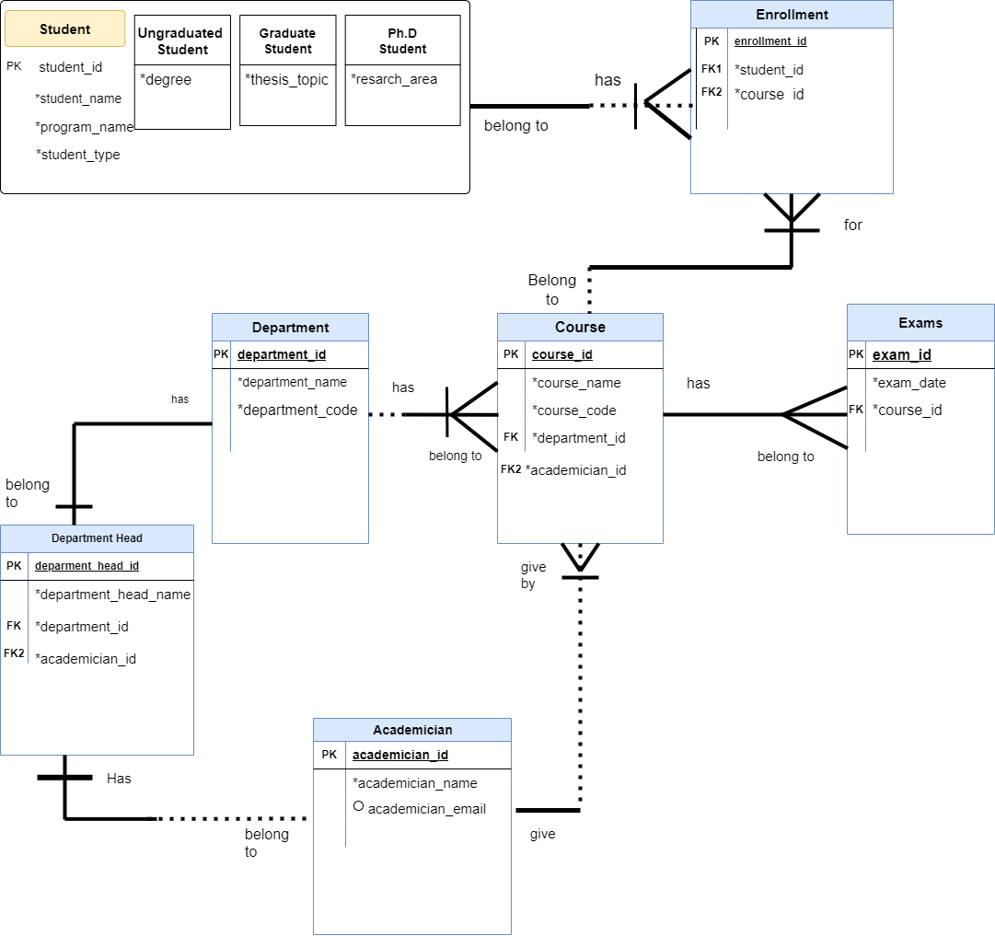

Slide 4
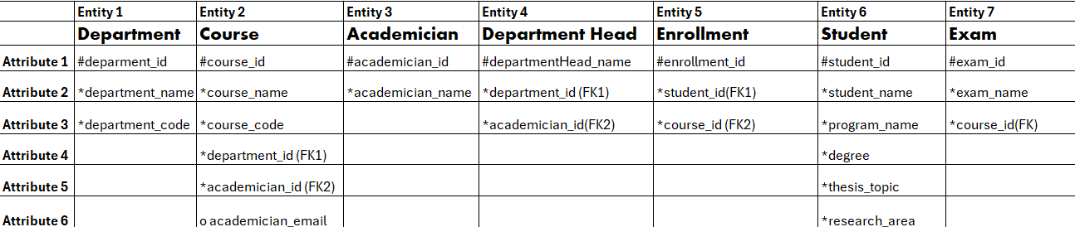
Entity- Attribute Dİagram

Slide 5
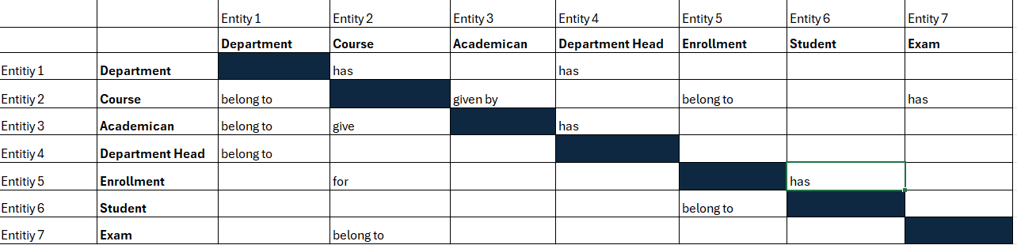
MATRİX DİAGRAM

Slide 6
tables

Slide 7
student
COLUMN NAME | KEY TYPE | DATA TYPE | FK TABLE | NULLABLE | İNSTANCE
STUDENT_ID | PK | NUMBER(10,0) |  | NO | 1
STUDENT_NAME |  | VARCHAR2(50) |  | NO | Arif Tunçer
PROGRAM_NAME |  | VARCHAR2(50) |  | NO | Computer Engineering
STUDENT_TYPE |  | VARCHAR2(50) |  | NO | Ungrauated
DDL Statements:
CREATE TYPE Ungraduate UNDER Student (
degree VARCHAR2(50)
);
CREATE TYPE Graduate UNDER Student (
thesis_topic VARCHAR2(50)
);
CREATE TYPE Phd UNDER Student (
research_area VARCHAR2(50)
);
CREATE TYPE COLLEGE_STUDENT AS OBJECT (
student_id INT,
student_name VARCHAR2(50),
program_name VARCHAR2(50),
student_type VARCHAR2(50),
);

Slide 8
academıcıan
COLUMN NAME | KEY TYPE | DATA TYPE | FK TABLE | NULLABLE | İNSTANCE
ACADEMICIAN_ID | PK | NUMBER(10,0) |  | NO | 6
ACADEMICIAN_NAME |  | VARCHAR2(50) |  | NO | Oğuz Fındık
DDL Statements:
INSERT INTO COLLEGE_Academician (Academician_id, Academician_name) VALUES
(1, 'İlhami Muharrem Orak'),
(2, 'Kürşat Mustafa Karaoğlan'),
(3, 'Ferhat Atasoy'),
(4, 'Hüseyin Altınkaya'),
(5, 'Sezer Pıçak'),
(6, 'Oğuz Fındık'),
(7, 'Hasan Gökkaya'),
(8, 'Ozan Gülbudak'),
CREATE TABLE COLLEGE_Academician (
Academician_id INT PRIMARY KEY,
Academician_name VARCHAR(50)
);

Slide 9
COURSES
COLUMN NAME | KEY TYPE | DATA TYPE | FK TABLE | NULLABLE | İNSTANCE
COURSE_ID | PK |  |  | NO | 2
COURSE_NAME |  |  |  | NO | DATABASE SYSTEM
COURSE_CODE |  |  |  | NO | DS
DEPARTMENT_ID | FK |  | DEPARTMENTS | NO | 1
ACADEMICIAN_ID | FK |  | ACADEMİCİANS | NO | 1
DDL Statements:
) CONSTRAINT fk_department
FOREIGN KEY (Department_id)
REFERENCES Department(Department_id),
CONSTRAINT fk_academician
FOREIGN KEY (Academician_id)
REFERENCES Academician(Academician_id)
);
CREATE TABLE COLLEGE_Courses (
Course_id INT PRIMARY KEY,
Course_name VARCHAR(50),
Course_code VARCHAR(50),
Department_id INT,
Academician_id INT,

Slide 10
departments
COLUMN NAME | KEY TYPE | DATA TYPE | FK TABLE | NULLABLE | İNSTANCE
DEPARTMENT_ID | PK | NUMBER(10,0) |  | NO | 2
DEPARTMENT_NAME |  | VARCHAR(50) |  | NO | ELECTRİCS_ELECTRONİCS E.
DEPARTMENT_CODE |  | VARCHAR2(50) |  | NO | EE
DDL Statements:
CREATE TABLE COLLEGE_Department (
Department_id INT PRIMARY KEY,
Department_name VARCHAR(50),
Department_code VARCHAR(50)
);
INSERT INTO COLLEGE_Department (Department_id, Department_name, Department_code) VALUES
(3, 'Mechanical Engineering', 'ME'),
(1, 'Computer Engineering', 'CE'),
(2, 'Electrics and Electronics Engineering', 'EE');

Slide 11
DEPARTMENT_HEADS
COLUMN NAME | KEY TYPE | DATA TYPE | FK TABLE | NULLABLE | İNSTANCE
DEPARTMENT_HEAD_ID | PK | NUMBER(10,0) |  | NO | 2
DEPARTMENT_HEAD_NAME |  | VARCHAR2(50) |  | NO | CE Head of department
DEPARTMENT_ID | FK | NUMBER(10,0) | DEPARTMENTS | NO | 1
ACADEMICIAN_ID | FK | NUMBER(10,0) | ACADEMİCİAN | NO | 6
DDL Statements:
CREATE TABLE COLLEGE_DepartmentHead (
Department_head_id INT PRIMARY KEY,
Department_head_name VARCHAR(50),
Department_id INT,
Academician_id INT,
CONSTRAINT fk_department_head_department
FOREIGN KEY (Department_id)
REFERENCES Department(Department_id),
CONSTRAINT fk_department_head_academician
FOREIGN KEY (Academician_id)
REFERENCES Academician(Academician_id)
);
INSERT INTO COLLEGE_DepartmentHead (Department_head_id, Department_head_name, Department_id, Academician_id) VALUES
(1, 'CE head of department', 1, 6),
(2, 'EE head of department', 2, 8),
(3, 'ME head of department', 3, 7);

Slide 12
ENROLLMENTS
COLUMN NAME | KEY TYPE | DATA TYPE | FK TABLE | NULLABLE | İNSTANCE
ENROLLMENT_ID | PK | NUMBER(10,0) |  | NO | 3
STUDENT_ID | FK | NUMBER(10,0) | STUDENT | NO | 2
COURSE_ID | FK | NUMBER(10,0) | COURSES | NO | 1
CREATE TABLE COLLEGE_Enrollment (
enrollment_id INT PRIMARY KEY,
student_id INT,
course_id INT,
CONSTRAINT fk_enrollment_student
FOREIGN KEY (student_id)
REFERENCES Student(student_id),
CONSTRAINT fk_enrollment_course
FOREIGN KEY (course_id)
REFERENCES Course(course_id)
);
DDL Statements:
INSERT INTO COLLEGE_Enrollment (enrollment_id, student_id, course_id) VALUES
(1, 1, 1),
(2, 1, 2),
(3, 2, 1),
(4, 2, 2);

Slide 13
EXAMS
COLUMN NAME | KEY TYPE | DATA TYPE | FK TABLE | NULLABLE | İNSTANCE
EXAM_ID | PK | NUMBER(10,0) |  | NO | 3
EXAM_DATE |  | DATE |  | NO | 05-Jun-2024
COURSE_ID | FK | NUMBER(10,0) | COURSES | NO | 2
DDL Statements:
INSERT INTO Exams (exam_id, exam_date, course_id) VALUES
(1, '2024-06-01', 1),
(2, '2024-06-02', 3),
(3, '2024-06-05', 2),
(4, '2024-05-29', 4),
(5, '2024-05-28', 5),
(6, '2024-06-09', 6);
CREATE TABLE COLLEGE_Department (
Department_id INT PRIMARY,
Department_name VARCHAR(50),
Department_code VARCHAR(50)
);

Slide 14
DML STATEMENTS

Slide 15
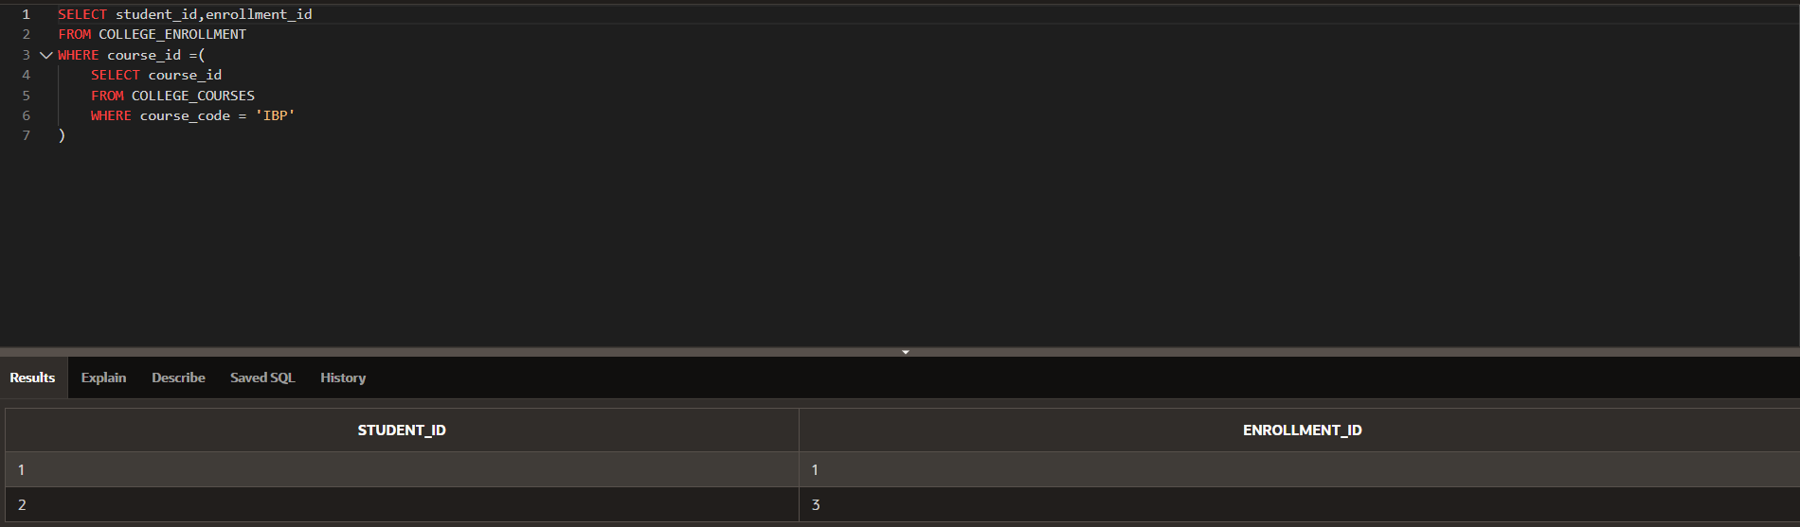
SUBQUERY

Slide 16
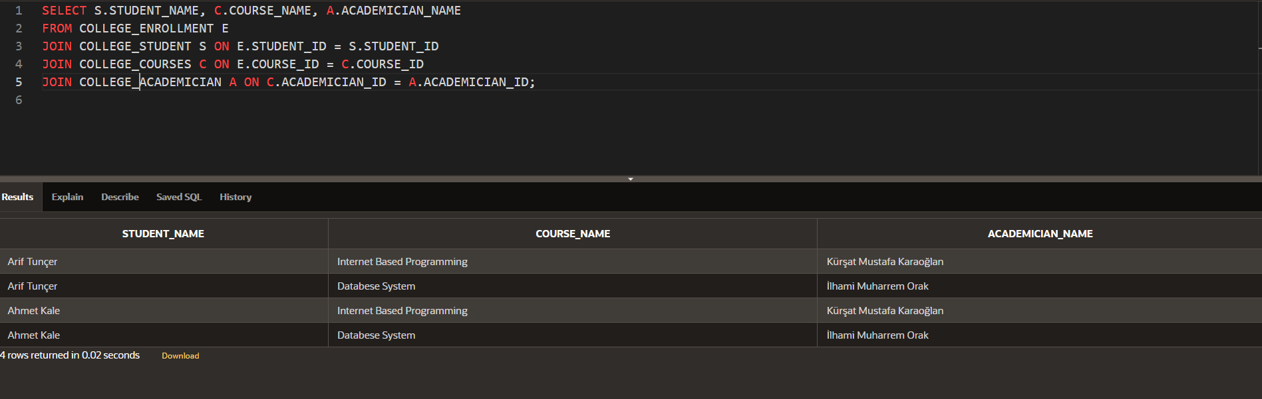
JOİN

Slide 17
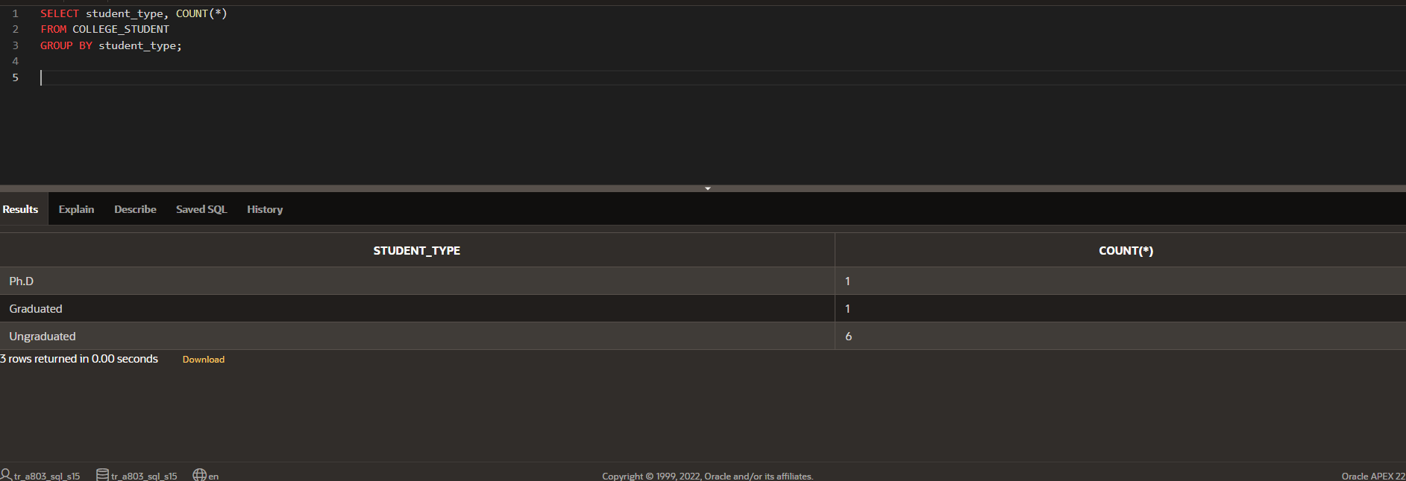
GROUP BY

Slide 18
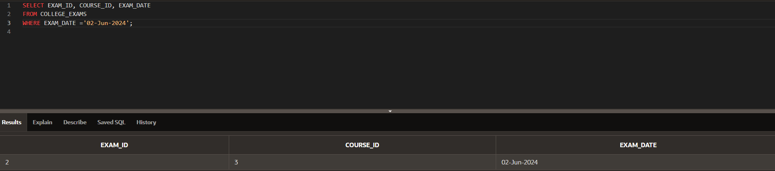
DATE

Slide 19
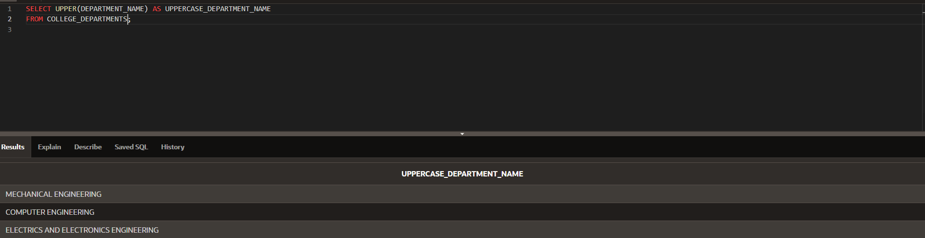
Character

Slide 20
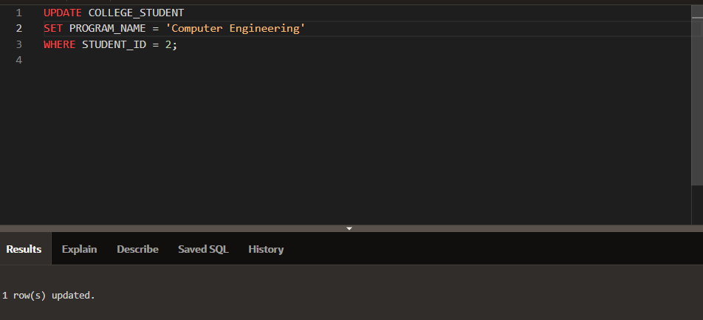
UPDATE

Slide 21
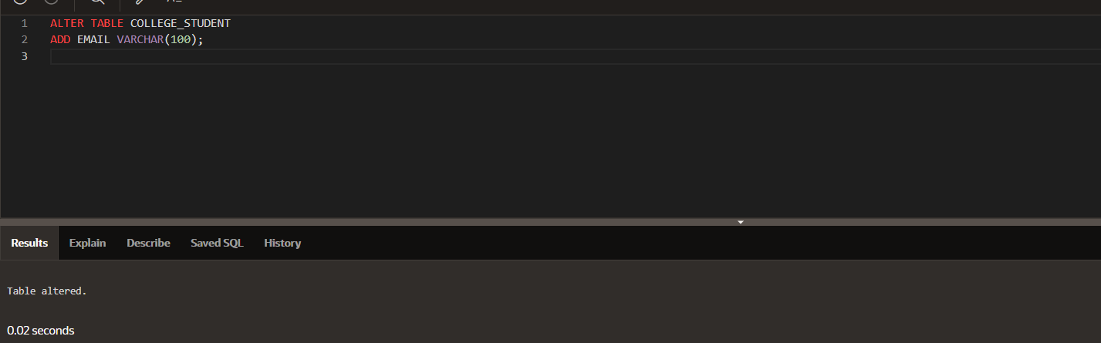
ALTER

